Slide 1
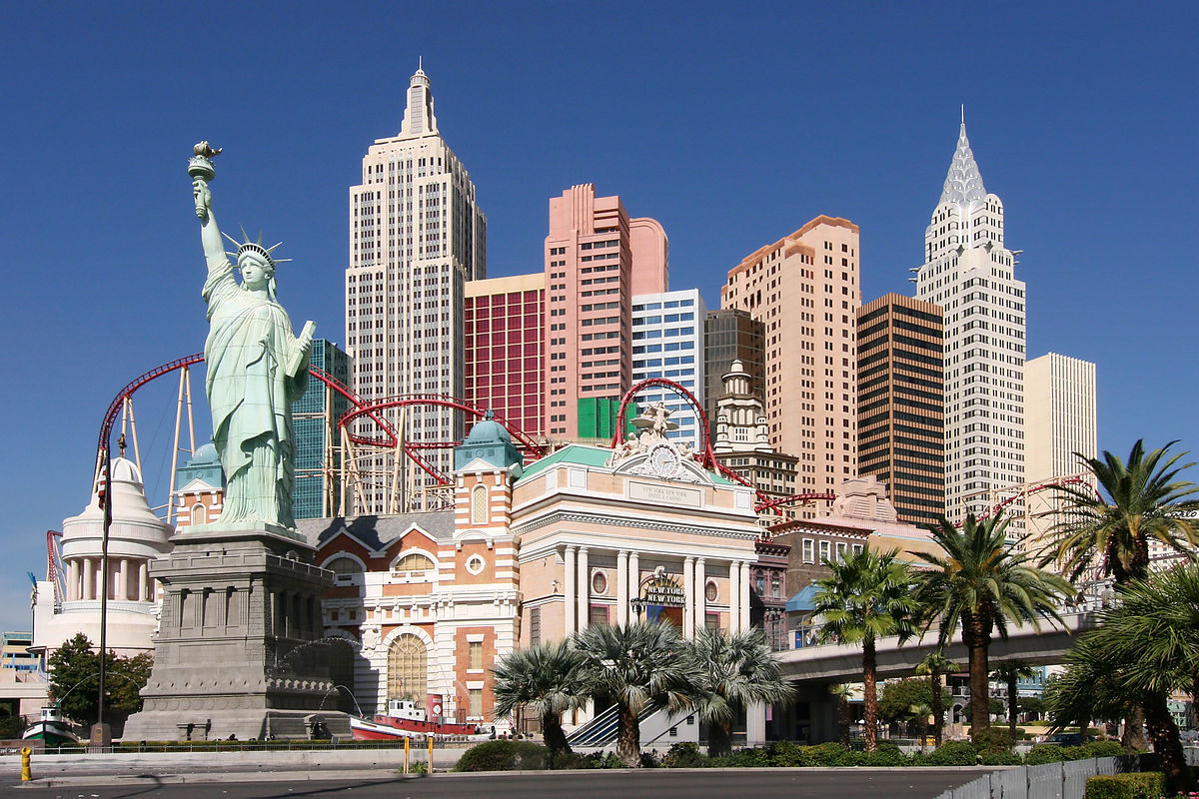


Coursera IBM Data Science Capstone Project Battle of Neighborhood Anil Nair

Slide 2
Objective
Provide recommendations on the preferable city based on similar neighbourhood to start a new business.
Applying unsupervised machine learning algorithm – K-Means clustering on different venues residing in and around the neighbourhood.

Slide 3
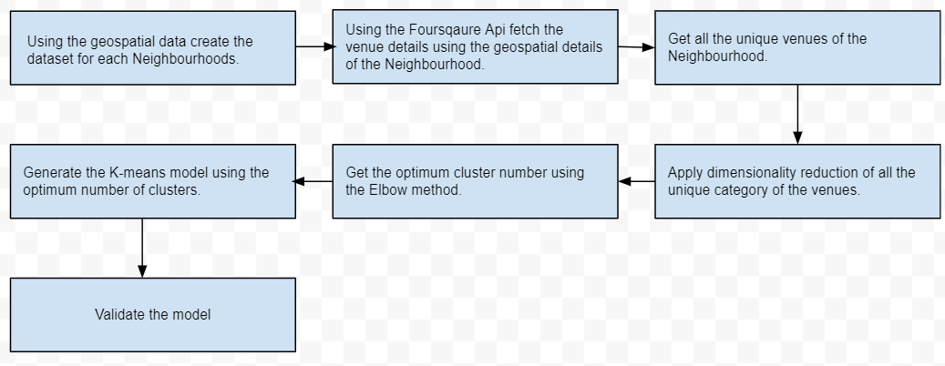
Methodology

Slide 4
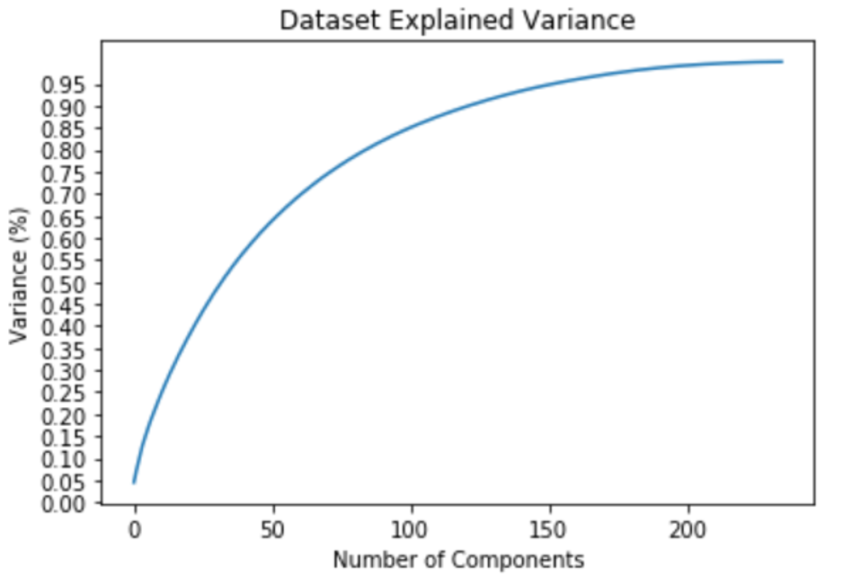
Feature selection using explained variance
The explained variance will provide the optimum value of the features to be used.
The optimised features will be used to form clusters using the K-means clustering Algorithm.

Slide 5
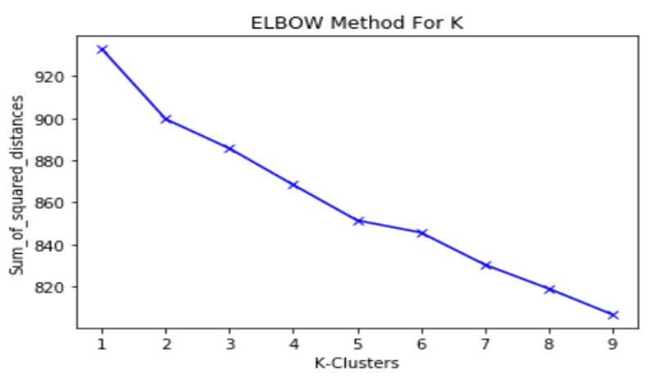
Optimum value of cluster – Elbow Method
The optimum value of cluster can be found by Elbow method.
From the plot, the optimum value of K is 5.

Slide 6
Optimum value of cluster – Elbow Method
The optimum value of cluster can be found by Elbow method.
From the plot, the optimum value of K is 5.

Slide 7
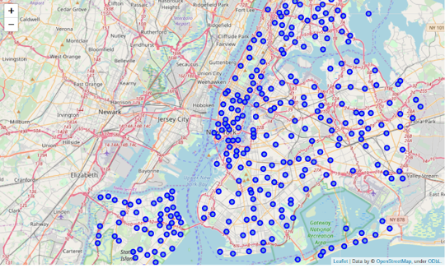
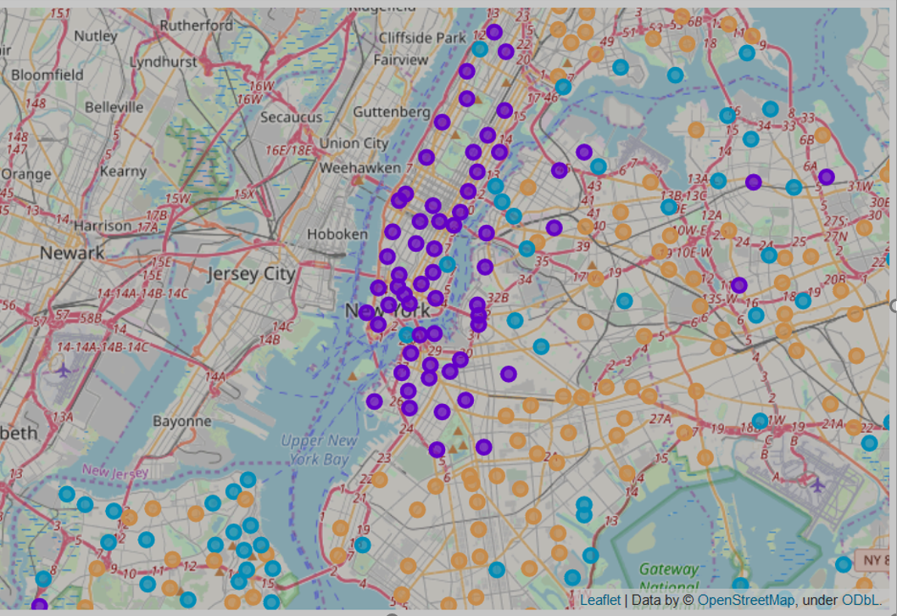
Clustering – New York
Before Clustering
After Clustering

Slide 8
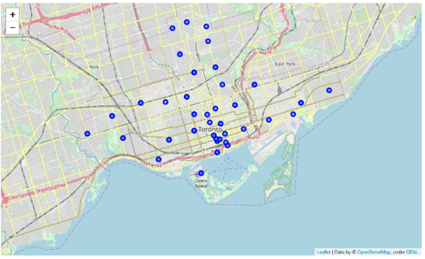
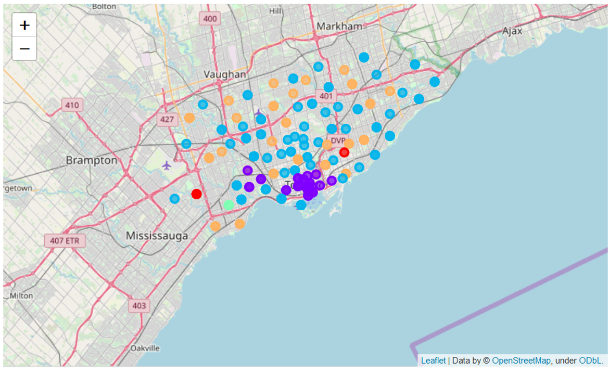
Clustering – Toronto
Before Clustering
After Clustering

Slide 9
Conclusion
The project work was done with limited number of samples. We can use more samples which will make our dataset balanced.
Based on clusters derived from the limited samples we could conclude that the New York neighbourhood has more business opportunities than Toronto.

Slide 10
Thank you

